Slide 1
Anthony O’Neal
Exit Interview

Slide 2
About Me
Born on April 14, 1999
My interest
Guitar
Skateboarding
Video games

Slide 3
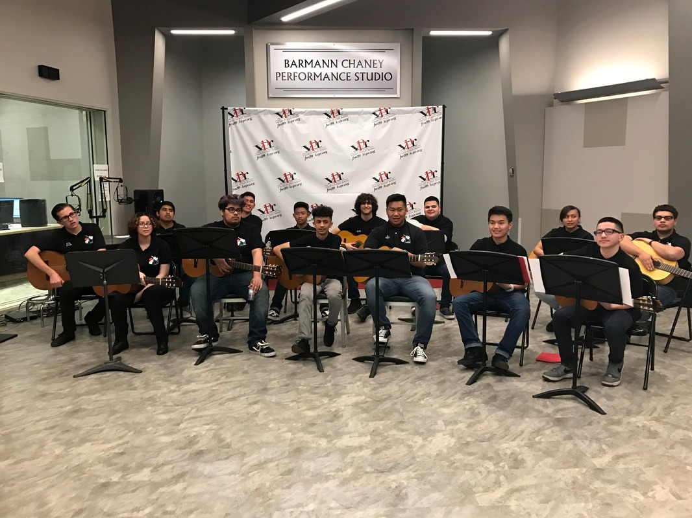
My High School Experience
Played guitar since freshman year
Joining guitar club
Joined football
Friends and classes

Slide 4
Struggles and Successes
Struggles
Procrastinating
Not doing work
Successes
Learning to overcome my struggles and acting right

Slide 5
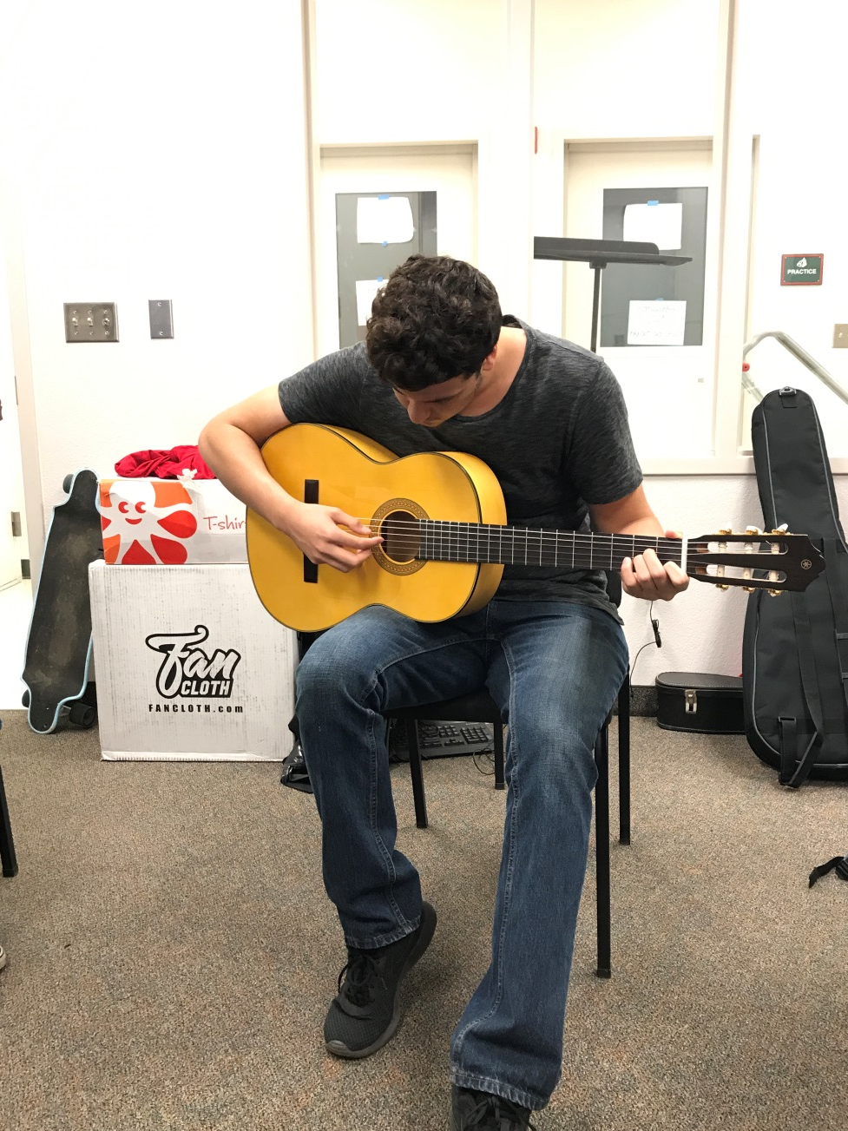
Pathway
Guitar

Slide 6
Job Shadow
Interviewed a boss at Sierra Valley Rehab Center
My experience with the interview
Reason for choosing this job shadow

Slide 7
Plans After High School
Go to college to study to be a physical therapist
Become a physical therapist for ankles
Find a job somewhere in a big city

Slide 8
Graduating LHS
What has it taught me?
What I’m going to miss?

Slide 9
Thank you very much for coming
Any Questions?

